Slide 1

Pump It Up
Prediction of Wellpoint status based on inspection information for Tanzania water authority

Slide 2
Problem Statement
“Using data from Taarifa and the Tanzanian Ministry of Water, can you predict which pumps are functional, which need some repairs, and which don't work at all? This is an intermediate-level practice competition. Predict one of these three classes based on several variables about what kind of pump is operating, when it was installed, and how it is managed. A smart understanding of which waterpoints will fail can improve maintenance operations and ensure that clean, potable water is available to communities across Tanzania.” – DrivenData

Slide 3
- Wellpoints are distributed throughout the country - Location columns include: Latitude Longitude Subvillage Ward LGA Region Code District Code Basin
Locations of Wellpoints

Slide 4
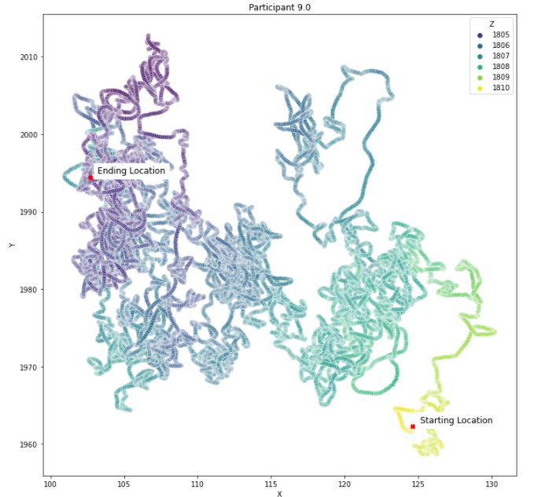
- Visual looking down at top of head - X – left to right, or side to side - Y – front to back - Z – height represented by color with lighter being higher and darker being lower
Motion

Slide 5
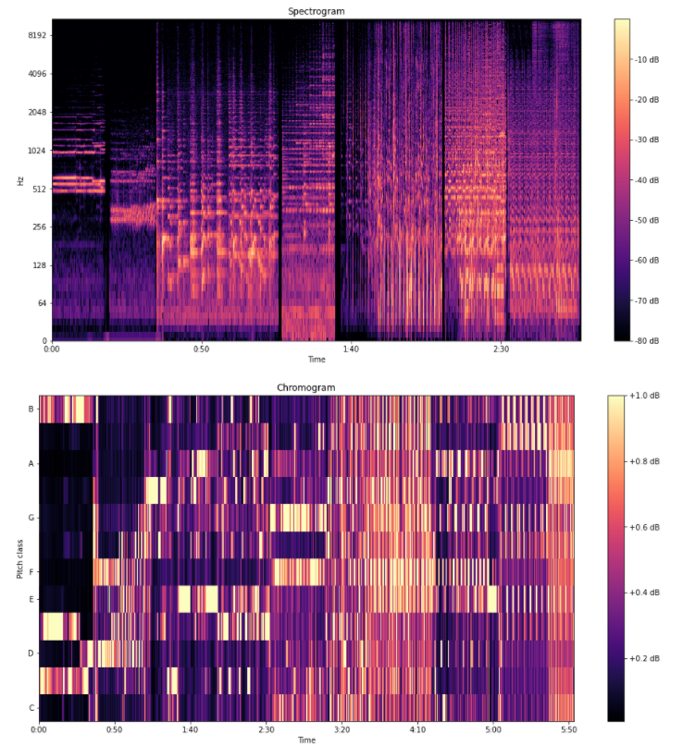

- Lento (#3) from György Ligeti Ten Pieces for Wind Quintet (20s) - Allegro con delicatezza (#8) from György Ligeti Ten Pieces for Wind Quintet (15s) - Adagio from Joaquin Rodrigo's Concierto de Aranjuez (40s) - Winter movement from Vivaldi's The Four Seasons (20s) - Left & Right by D'Angelo, featuring Method Man & Redman (35s) - Marcando la distancia by Manolito y su trabuco(20s) - Cubic by 808 State (30s)
Musical Stimuli

Slide 6
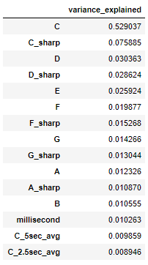
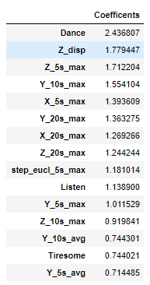
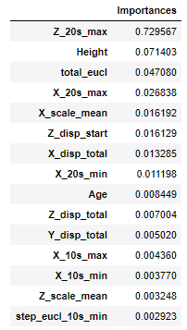
Relevant Feaures

Slide 7
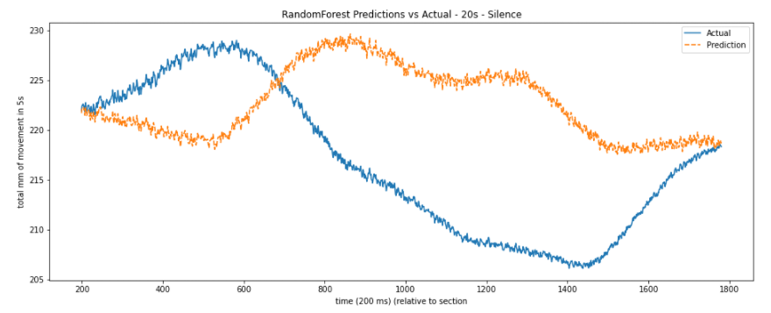
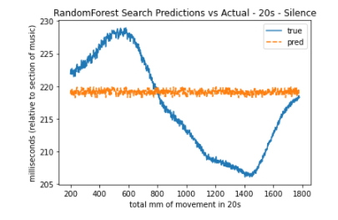
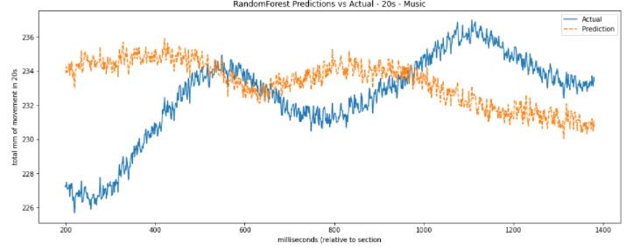
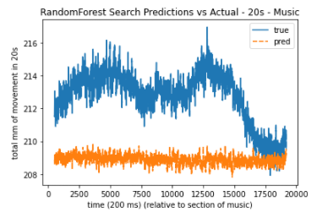
Random Forest Regressor

Slide 8
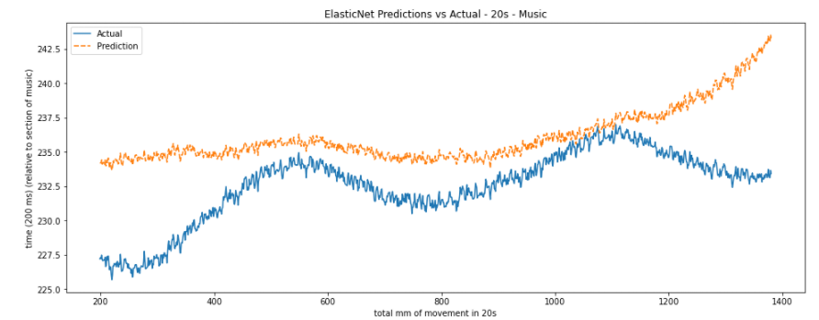
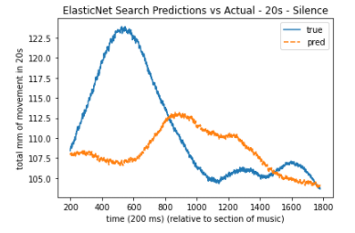
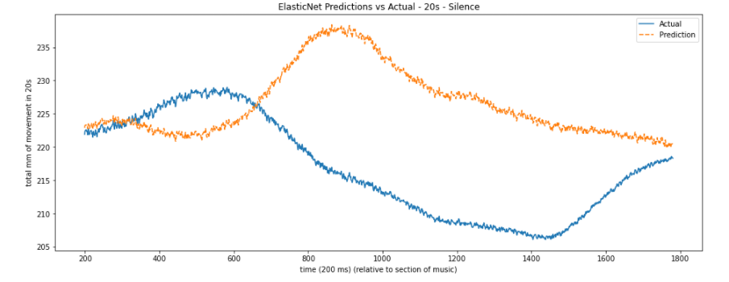
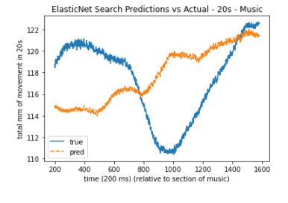
ElasticNet

Slide 9
Conclusions
Based upon the results that were found the predictive power of previous motion and musical stimuli is inconclusive. The models do consistently score above a mean strategy dummy indicator, but don’t do well with matching the actual trends in the data. Additional algorithms could be used with potentially better results, but there is nothing in the current results that points towards a definitive answer.
Different lines of inquery are still available for study such as:
Men vs. women
Types of music (segments) broken out
Training on data from 2/3 of participants fully and testing on remaining
Together, silence separate, music separate

